Slide 1
Law and Governance

Slide 2
Law. Governance. Leadership.
theoretical and practical knowledge
networking and cultural events
intersection of law and public management

Slide 3
Structure of studies
the programme is 60 credits / 5 modules
Public Law Module
(12 credits)
Law and Government Module
(12 credits)
Communication and Skills Module
(12 credits)
Law and Legislation (Parliaments) Module (8 credits)
International and Supranational Governance Module
(8 credits)
Project course
(8 credits)

Slide 4
COURSES
Winter Semester
Summer Semester
Comparative Constitutional Law
Democracy, Elections, Representation
Comparative Government
Corporate Governance
Quality of Legislation
Legislative Studies – Parliaments Compared
International Organisations and Decision Making
Media Law and Governance
Public Speaking
Democracy, Elections, Representation
ECHR case law
Constitutional Courts Compared
IT in governance (E-government, big data)
EU Policies. EU Decision Making. Comitology
Protocol
Project

Slide 5
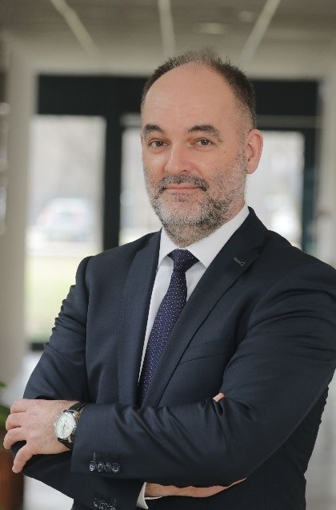
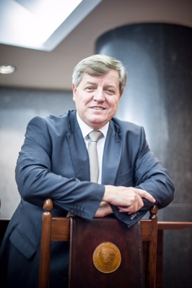
Supervisors
Péter Smuk
professor,
dean
István Stumpf
professor, former judge of the Constitutional Court
smuk@sze.hu
stumpf@sze.hu

