Slide 1
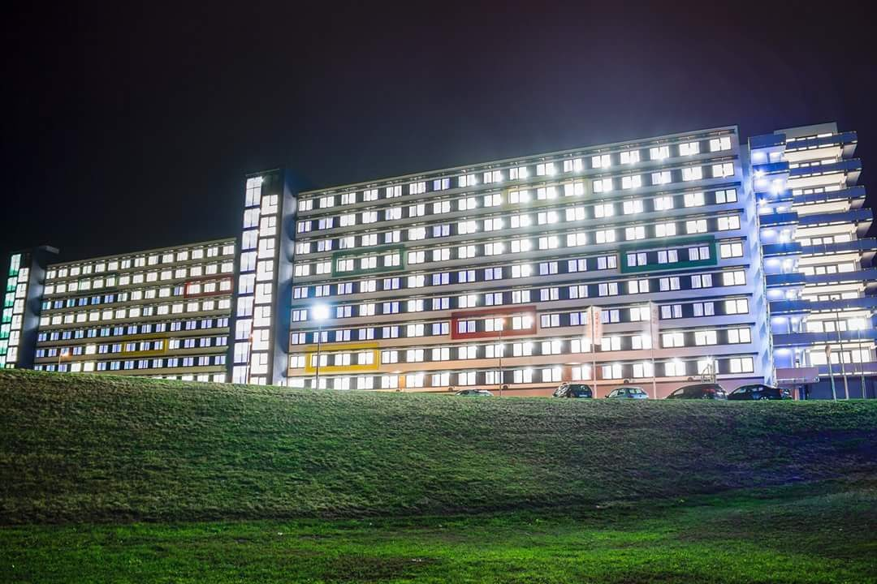
Good to know about the Dormitories
Administrative information for international students

Slide 2
Arrival information
Upon your arrival please go to check-in at the K1 building’s reception.
At the reception you will have to pick up your room key and temporary pass.
Please read the attached leaflet carefully for further instructions.
The temporary pass will be paper based which you will have to carry with you at all times when entering and leaving the dormitory building.

Slide 3
AFTER ARRIVAL - MAIN STEPS
After arrival all students must make a university card which will be later used to enter and leave the dormitories. (see more information as follows next page)
The university card will only fully function after you register your fingerprint to the card.
Once you have your university card you will have to sign your dormitory contract which will activate the card.

Slide 4
University card
The first university card is 1.500 HUF. All students must pay for their student card!
The student cards are produced in the University Information and Service Center This office is located in the main building of the campus (New Knowledge Space Building/Új tudástér ÚT-106 – AKIK space) on the ground floor. web: kartya.sze.hu
Use of the student card is MANDATORY. Non-compliance with the guidelines regarding the use of the student cards will result in disciplinary action.
If the student card is damaged or lost you must replace it as soon as possible. You must let the accommodation office know immediately to receive a temporary pass.
The fee for replacement card is 3.500 HUF.
You can pay for the student card by cash or card.

Slide 5
University Card-Fingerprint registration
To fully activate your student card you will have to register your fingerprint.
Fingerprint registration times available at:
https:/internet.sth.sze.hu/beleptetes
email: ujj@netclub.sze.hu
OR
Posted at every building’s reception.

Slide 6
Signing the contract
After arriving please visit the Accommodation Office during Office Hours to sign your dormitory contract before the temporary pass expires.
The Accommodation Office is located on the ground floor of the K1 building to the left of the elevators and staircase.
All students must report any damages within 3 days after moving in to : accommodation@sze.hu
If damage is not reported within this period the student can be held liable for those damages.

Slide 7
OFFICE HOURS & CONTACT
Student Information and Service Center
University card
Accommodation Office
Dormitory
Ms Teodóra Gulrich
Ms Mónika Omischl-Soós
accommodation@sze.hu
Location: Multifunctional Building K1 ground floor
Office Hours:
Monday to Thursday :
9.00 am – 11.00 am
1.00 pm – 3.00 pm
Friday:
9.00am – 11.00am
web: kartya.sze.hu
email: kartya@sze.hu
Location: ÚT-106 (AKIK)
Office Hours:
Monday to Thursday :
8.00 am – 4.00 pm
Friday:
8.00 am – 2.00 pm

Slide 8
Dormitory Fee - Scholarship Students
The scholarship will directly pay the University for the dormitory fees.
If you would like to move out of the dormitory you have a 1 month grace period to decide whether you would like to stay in the dorm or not.
If you decide to move out from the dormitory after the first month you will have to notify the Accommodation Office. In this case you will be eligible to receive the accommodation support yourself. Please note this is only possible if you move out before the end of the grace period!!
If you would like to move out after the grace period you will NOT be eligible to receive the accommodation support. As per the dormitory policy and contract states.
1st grace period ends 5th of October, 2nd grace period ends 5th of March. No exception!

Slide 9
Dormitory Fee - Self Funded Students
New students have already paid (along with their student fees) for their first month of accommodation. If you decide to stay for the semester after the first month you need to pay the rest (4 months fee in one amount).
Unfortunately we can’t count half months or so. If you stay a day in the dorm we have to charge the whole month fee (according to the dormitory policy).
If you decide to leave the dorm within the first month, you don’t need to pay for the rest.
If you decide to leave the dorm after the first month, we cannot pay back the rest.

Slide 10
Dormitory Fee – Erasmus Students
You have to pay the first month before arriving to the dormitory. If you decide to stay for the semester after the first month you need to pay the rest (4 months fee in one amount).
Unfortunately we can’t count half months or so. If you stay a day in the dorm we have to charge the whole month fee (according to the dormitory policy).
If you decide to leave the dorm within the first month, you don’t need to pay for the rest.
If you decide to leave the dorm after the first month, we cannot pay back the rest.

Slide 11
Deadlines of fees
Deposit and first month fee for Erasmus students: 15.09.2023
We ask you to pay a security deposit of 20.000 HUF which will be paid back at the end of the semester in case you don’t cause any damage in your room or in the dormitory.
If you arrive after the 15th of September you have 10 days to pay both the deposit and the first month dormitory fee
Deadline for the rest of the payment (months October-January) 15.10.2023

Slide 12
PAYMENT Information
You can pay through bank transfer using the following information
IBAN: HU76 10300002-10801842-00014908
SWIFT/BIC: MKKBHUHB
Comment: NAME, dorm fee, KOVH26009T
Or by postal cheque which you can pick up from the Accommodation Office during Office Hours
Fees:
40.000 HUF/month/person
If you are studying in the Stipendium Hungaricum program, the program will cover this for you.

Slide 13
DORMITORY – in general
If you live in the dormitory you have to follow the rules - To certify this, you have to sign the Student Dormitory Contract, which has two coherent attachment:
Hostel Policy
Fire-protection regulations
Can be downloaded from the dormitory’s website
The room have to be cleaned by the students! – We have the right to check it randomly, if it’s not cleaned you’ll get a penalty – 15.000 HUF/person
All students live in pairs, there is no opportunity to have an individual room.
Non compliance with either the Hostel Policy or the Fire-protection regulations can and will lead to disciplinary action. All disciplinary action will result in penalty or expulsion in accordance with the policies.

Slide 14
Most Important DORMITORY Regulations
Every time you enter the gate of the dormitory, you have to use your university card. Non-compliance with this requirement will result in disciplinary action!
It is forbidden to smoke or use electronic cigarettes in the dormitory. – Smoking is allowed at the place of SMOKING AREA, and more than 5 meters from the building. Smoking in non designated SMOKING AREAS will result in expulsion.
Covering the fire alarm system will be punished with expulsion.

Slide 15
Other important DORMITORY Regulations
Study rooms are open 24/7. Please refer to the rules of use posted on the door’s of the study rooms.
Prayer rooms Male only (k3 3rd floor) Female only (k1 9th floor) may be used after picking up the keys from the respective reception. Students taking the key must sign before taking the key and must return the key and sign the ledger once again. The rules of using the prayer room is posted on the doors.
Guests at the dormitory must be requested at dormitory.sze.hu
Asking permission to organize an event (birthday party, dinner etc.): dormitory.sze.hu

Slide 16
SERVICES - Renting bedding
Bed sheets:
You can rent bed sheets for 2.000 HUF/semester
You can pay via Postal cheque which you can pick up from the Accommodation Office during Office Hours
You have to wash it for yourself – you have the opportunity at all our dormitories
If you give it back damaged we will deduct 8.000 HUF from your deposit
Maintenance:
Reporting technical issues: help.sze.hu
OR by email: accommodation@sze.hu

Slide 17
SERVICES - Internet
Internet:
WIFI using for the 1st device is free of charge. You can sign up on this link: internet.sth.sze.hu (recommended for the 1st device is a laptop)
Further devices cost 2.000 HUF/semester/device for mobile, or 6500 HUF/semester/device for laptop, it depends on the package size (Payed via postal cheque found at the K1 reception)
If you paid it:
You can write an email to payment@netclub.sze.hu, send the picture of the paid cheque
OR You can upload it to the internet.sth.sze.hu

Slide 18
SERVICES - Kitchen
Located at the end of every corridor.
The kitchens are open 24/7.
All of the kitchens are equipped with:
Cupboard
Hob (hot plate)
Owen
Microwave
Sink (Do not pour used oil in the sink, Please take the used oil to the nearest oil collection bin)
Oil collection bin (Every kitchen in the K3 and K0 buildings)
Every equipment must be used as intended.
Improper use of the equipment is considered as intentional damage therefore can and will result in disciplinary action!

Slide 19
SERVICES - Laundry and disinfection
LAUNDRY
in Hegedűs Gyula Dormitory on the 2nd floor;
in Multifunction Building on the 1st floor
Bathroom disinfection
Colleagues of the UNI-Famulus Ltd carries out regular disinfection of all bathrooms (includings ones within the dorm rooms).
The scheduel for the disinfectation can be found on kollegium.sze.hu
Reminder rooms and common areas (entryway or bathrooms) MUST be cleaned by the students the bathroom disinfection is not cleaning and if the bathrooms are not cleared at the time of disinfection the disinfection will NOT be carried out.

Slide 20
SERVICES - Health
MEDICAL CARE: Dr. Magdolna Papp, 9026 Győr, Kálóczy tér 9.
Monday, Wednesday and Friday 7am-11am
Tuesday and Thursday 10am-2pm

Slide 21
Important Contacts
Technical problem
Please report it on the website help.sze.hu
Problem with your card
Please write to kartya@sze.hu
Problem with your fingerprint or internet
Please write to problema@netclub.sze.hu
Problem with the dormitory
Please write to accommodation@sze.hu

Slide 22
Thank you for your kind attention!

